Slide 1
Chapter 5 IMAGE RESTORATION
Things which we see are not by themselves what we see…. It remains completely unknown to us what the objects may be by themselves and apart from the receptivity of our senses. We know nothing but our manner of perceiving them.
Immanuel Kant
Image enhancement is largely a subjective process, while image restoration is for the most part an objective process.
Restoration attempts to reconstruct or recover an image that has been degraded by using a priori knowledge of the degradation phenomenon.
Restoration techniques are oriented toward modeling the degradation and applying the inverse process in order to recover the original image.
This type of restoration approach usually involves formulation a criterion of goodness that will yield an optimal estimate of the desired result.

Slide 2
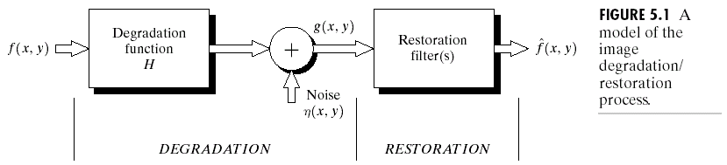
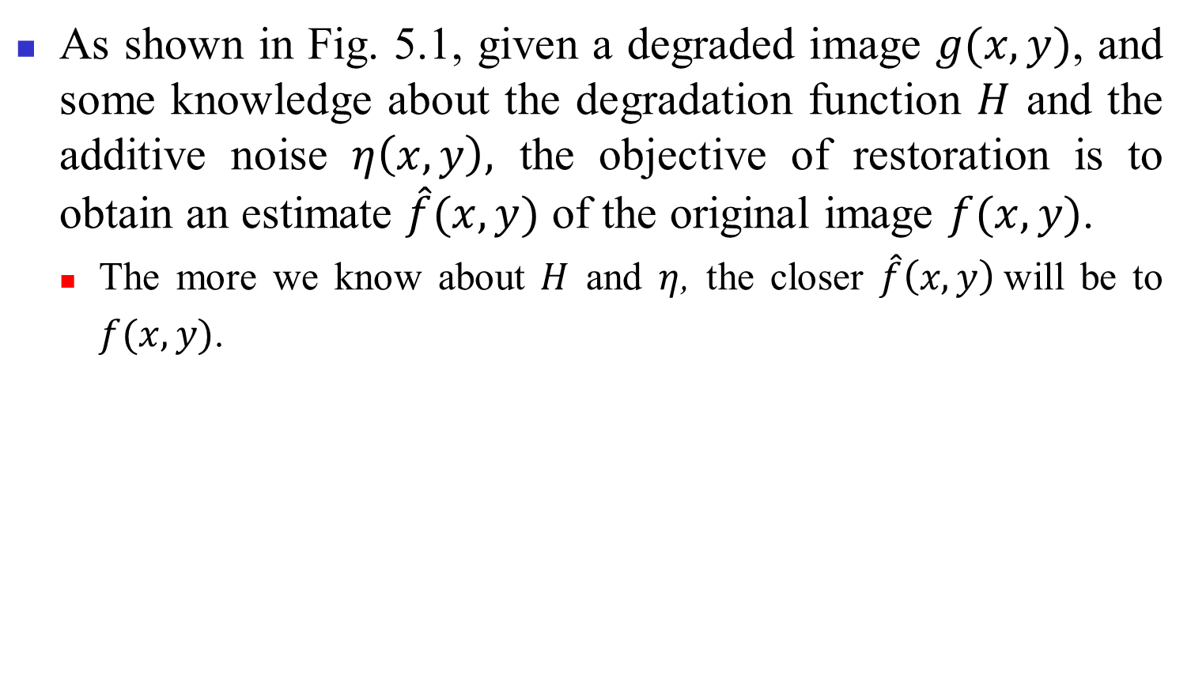
Model of Image Degradation/Restoration Process
As shown in Fig. 5.1, given a degraded image $g(x, y)$, and some knowledge about the degradation function $H$ and the additive noise $η\left(x,y\right),$ the objective of restoration is to obtain an estimate $\hat{f}(x,y)$ of the original image $f(x, y)$.
The more we know about $H$ and $η$, the closer $\hat{f}\left(x,y\right)$will be to
$f(x, y)$.

Slide 3
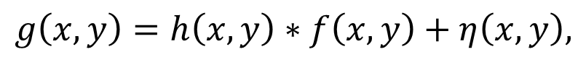
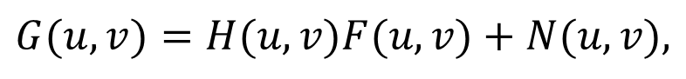
If H is a linear, position-invariant process, then the degraded image is given in the spatial domain by:
(5.1-1)
where h(x, y) is the spatial representation of the degradation function and “ ” indicates spatial convolution.
Equivalently,
(5.1-2)
where the terms in capital letters are the Fourier transforms of the corresponding terms in Eq. (5.1-1).
$$g\left(x,y\right)=h\left(x,y\right)∗f\left(x,y\right)+η\left(x,y\right),$$
$$G(u,v)=H(u,v)F(u,v)+N(u,v),$$

Slide 4
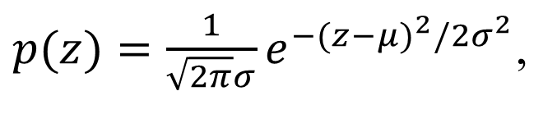
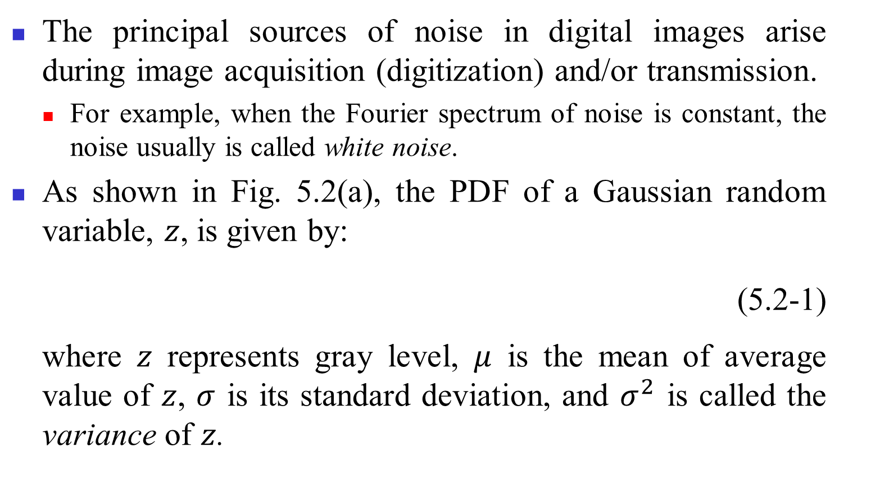
Noise Models
The principal sources of noise in digital images arise during image acquisition (digitization) and/or transmission.
For example, when the Fourier spectrum of noise is constant, the noise usually is called white noise.
As shown in Fig. 5.2(a), the PDF of a Gaussian random variable, $z$, is given by:
(5.2-1)
where $z$ represents gray level, $μ$ is the mean of average value of $z$, $σ$ is its standard deviation, and $σ^{2}$ is called the variance of $z$.
$p(z)=\frac{1}{\sqrt{2π}σ}e^{−(z−μ)^{2}/2σ^{2}}$,

Slide 5
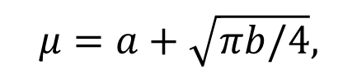
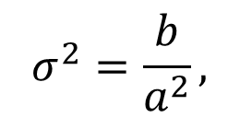
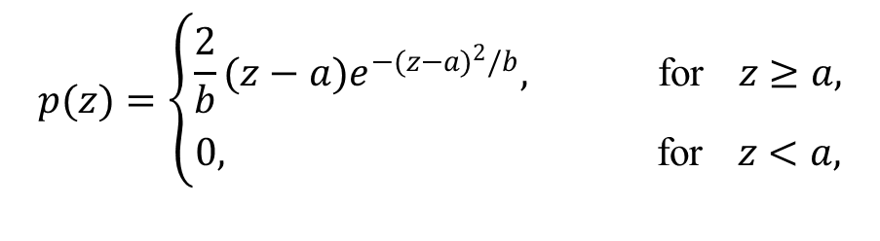
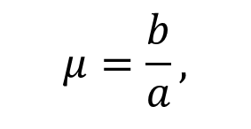
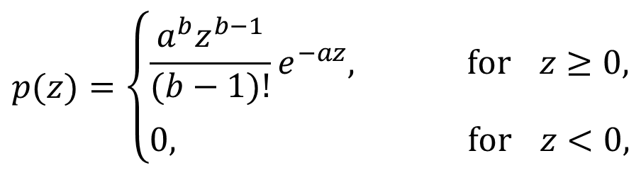
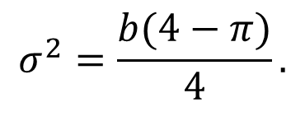
As shown in Fig. 5.2(b), the PDF of Rayleigh noise is given by:
(5.2-2)
(5.2-3)
(5.2-4)
As shown in Fig. 5.2(c), the PDF of Erlang noise is given by:
(5.2-5)
(5.2-6)
(5.2-7)
where the parameters are such that a > 0, b is a positive integer, and “!” indicates factorial.
$$p(z)=\left\{\begin{aligned}\frac{2}{b}(z−a)e^{−(z−a)^{2}/b}, \text{for} z≥a, \\ 0, \text{for} z<a,\end{aligned}\right.$$
$$μ=a+\sqrt{πb/4},$$
$$σ^{2}=\frac{b(4−π)}{4}.$$
$$p(z)=\left\{\begin{aligned}\frac{a^{b}z^{b−1}}{(b−1)!}e^{−az}, \text{for} z≥0, \\ 0, \text{for} z<0,\end{aligned}\right.$$
$$μ=\frac{b}{a},$$
$$σ^{2}=\frac{b}{a^{2}},$$

Slide 6
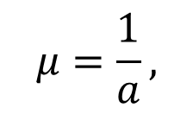
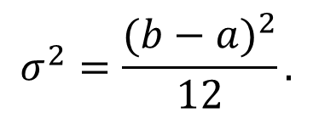
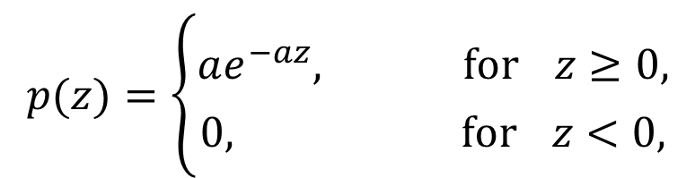
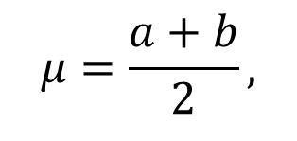
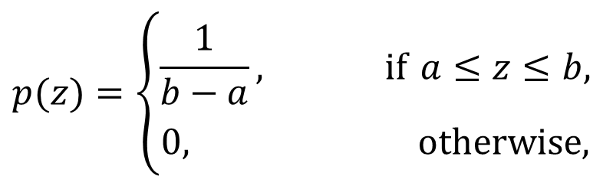
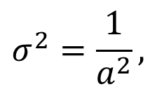
()
As shown in Fig. 5.2(d), the PDF of exponential noise is given by:
(5.2-8)
(5.2-9)
(5.2-10)
where a > 0. Note that it is a special case of the Erlang PDF with b =1.
As shown in Fig. 5.2(e), the PDF of uniform noise is given by:
(5.2-11)
(5.2-12)
(5.2-13)
$$p(z)=\left\{\begin{aligned}ae^{−az}, \text{for} z≥0, \\ 0, \text{for} z<0,\end{aligned}\right.$$
$$μ=\frac{1}{a},$$
$$σ^{2}=\frac{1}{a^{2}},$$
$$p(z)=\left\{\begin{aligned}\frac{1}{b−a}, \text{if} a≤z≤b, \\ 0, \text{otherwise}\text{,}\end{aligned}\right.$$
$$μ=\frac{a+b}{2},$$
$$σ^{2}=\frac{(b−a)^{2}}{12}.$$

Slide 7
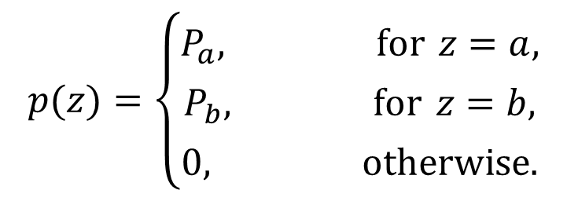
As shown in Fig. 5.2(f), the PDF of (bipolar) impulse noise is given by:
(5.2-14)
If b > a, gray-level b will appear as a light dot in the image. Conversely, level a will appear like a dark dot. If either P_{a} or P_{b} is zero, the impulse noise is called unipolar.
Shot and spike noise are terms used to refer to this type of noise.
$$p(z)=\left\{\begin{aligned}P_{a}, \text{for} z=a, \\ P_{b}, \text{for} z=b, \\ 0, \text{otherwise}\text{.}\end{aligned}\right.$$

Slide 8
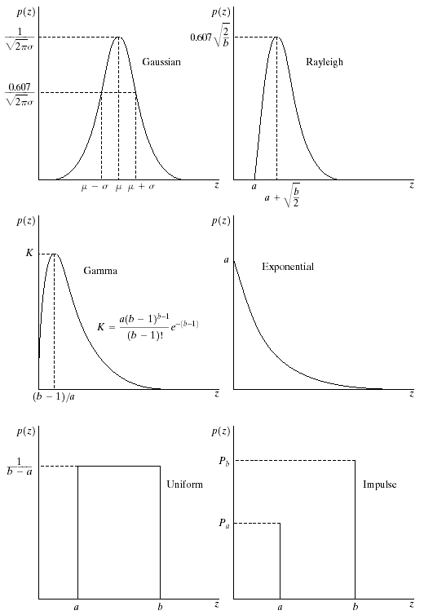
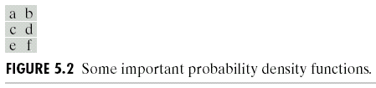

Slide 9
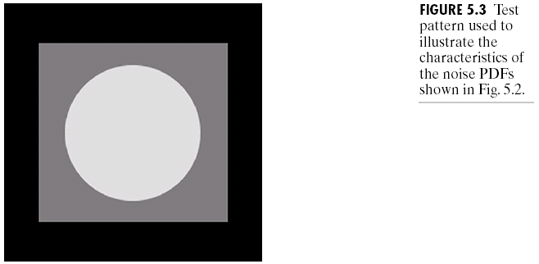
Fig. 5.3 shows a test pattern well-suited for illustrating the above noise models and Fig. 5.4 shows the images showing the test pattern after addition of the six types of noise and the corresponding histograms.

Slide 10
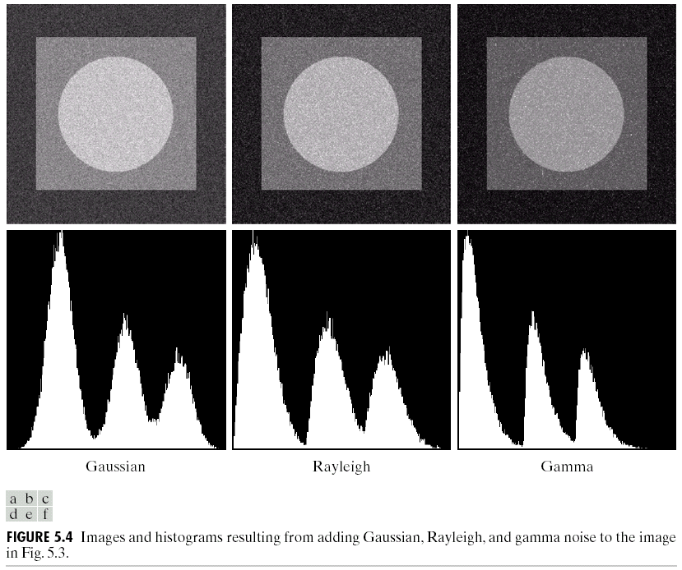

Slide 11
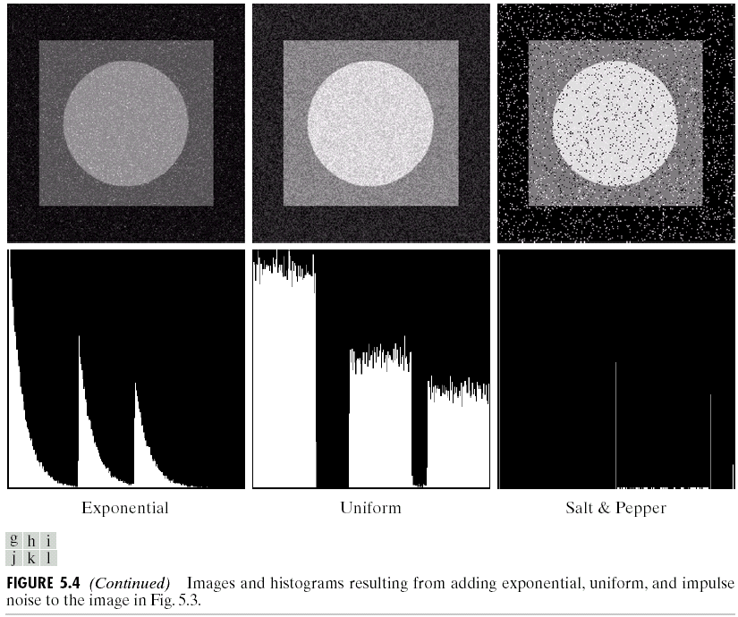
Even their histograms are significantly different, it is difficult to differentiate visually between the first five images in Fig. 5.4.

Slide 12
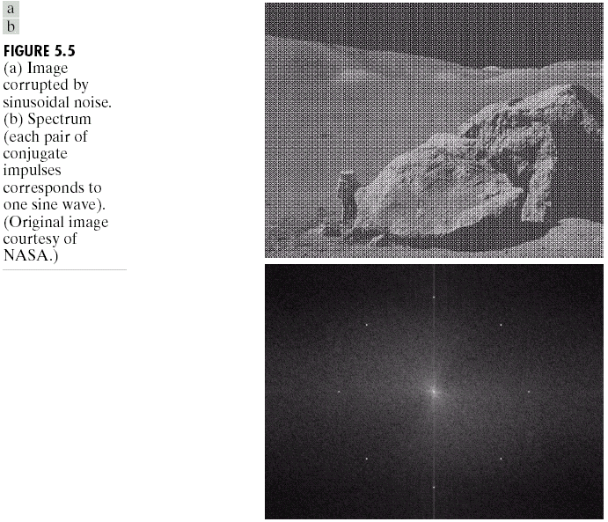
Periodic noise
Periodic noise in an image rises typically from electrical or electromechanical interference during image acquisition.
Consider the image in Fig. 5.5(a), which is severely corrupted by spatial sinusoidal noise of various frequencies, shown in Fig. 5.5(b).

Slide 13
Noise parameter estimation
The parameters of periodic noise typically are estimated by inspection of the Fourier spectrum of the image.
Automated analysis is possible in situations in which the noise spikes are either exceptionally pronounced, or when some knowledge is available about the general location of the frequency components of the interference.
If the imaging system is available, one simple way to study the characteristics of system noise is to capture a set of images of “flat” environments.
When only images already generated by the sensor are available, frequently it is possible to estimate the parameters of the PDF from small patches of reasonably constant gray level.
The vertical strips shown in Fig. 5.6 were cropped from the Gaussian, Rayleigh, and uniform images in Fig. 5.4. The histograms shown were calculated using image data from these small strips.

Slide 14
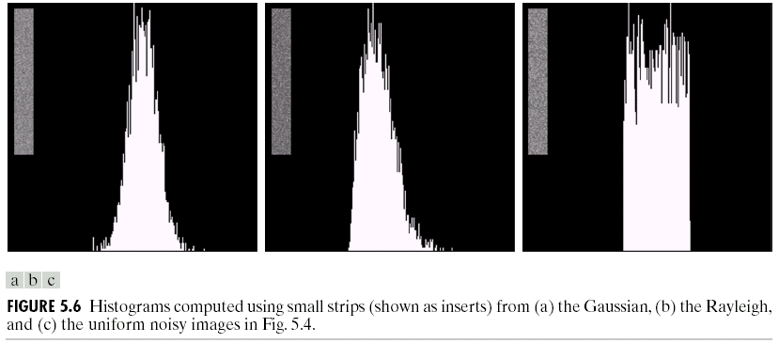
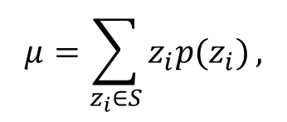
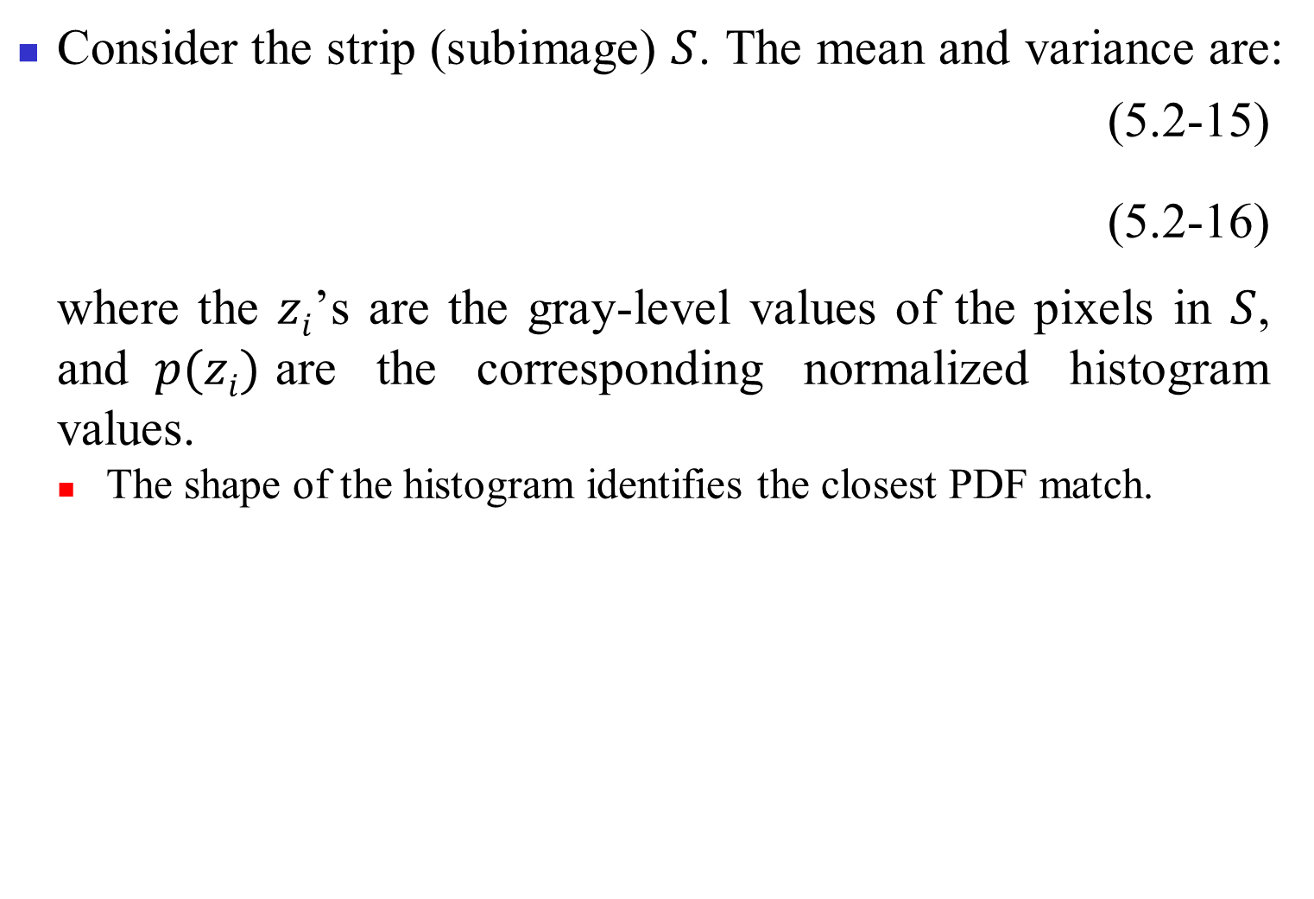
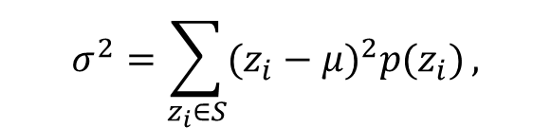
Consider the strip (subimage) $S$. The mean and variance are:
(5.2-15)
(5.2-16)
where the $zi$’s are the gray-level values of the pixels in $S$, and$p(zi)$are the corresponding normalized histogram values.
The shape of the histogram identifies the closest PDF match.
$$μ=\sum_{z_{i}∈S}{z_{i}p(z_{i})},$$
$$σ^{2}=\sum_{z_{i}∈S}{(z_{i}−μ)^{2}p(z_{i})},$$

Slide 15
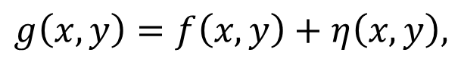
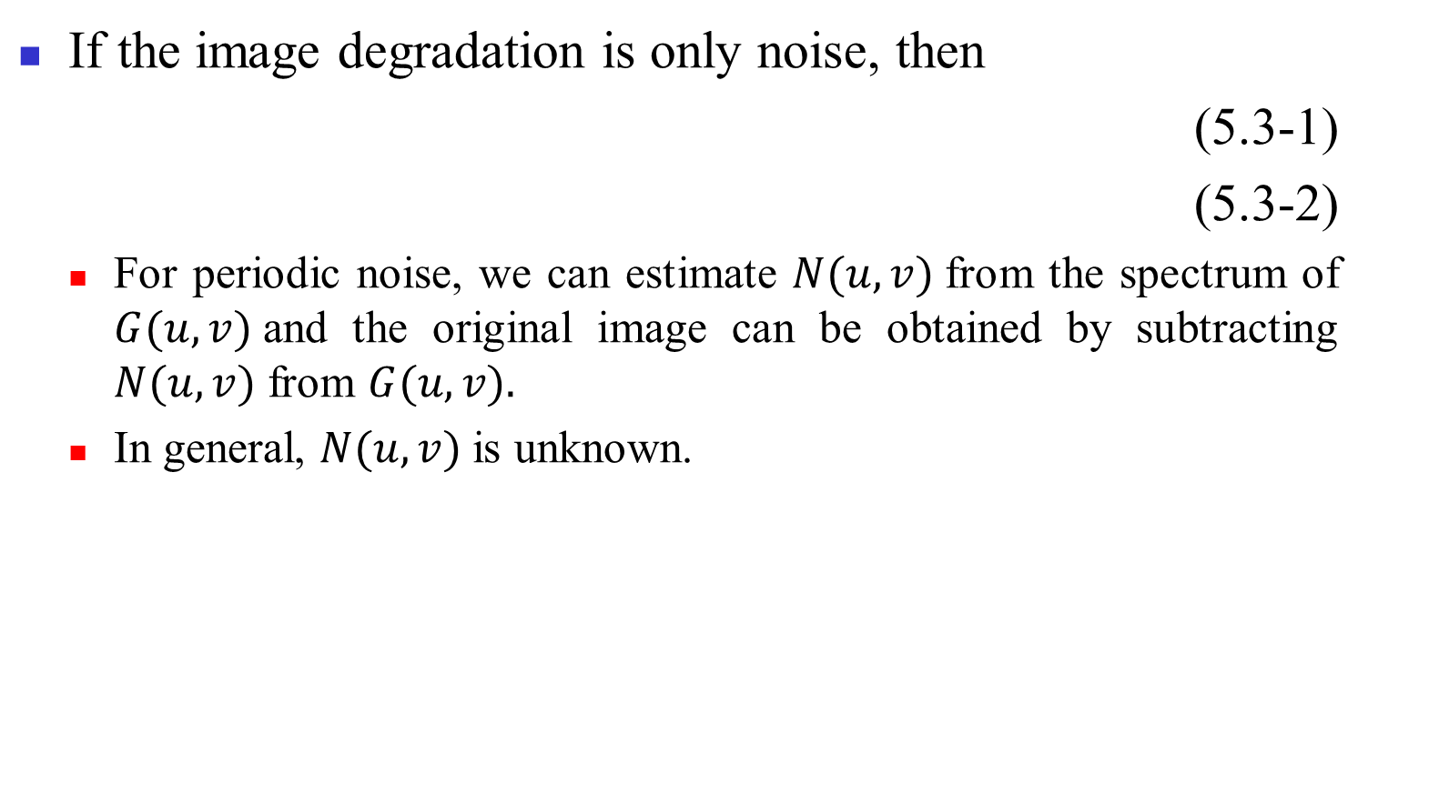
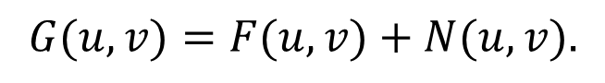
Restoration By Spatial Filtering
If the image degradation is only noise, then
(5.3-1)
(5.3-2)
For periodic noise, we can estimate $N(u, v)$from the spectrum of $G(u, v)$and the original image can be obtained by subtracting $N(u, v)$ from $G(u, v).$
In general, $N(u, v)$is unknown.
$$g\left(x,y\right)=f\left(x,y\right)+η\left(x,y\right),$$
$$G(u,v)=F(u,v)+N(u,v).$$

Slide 16
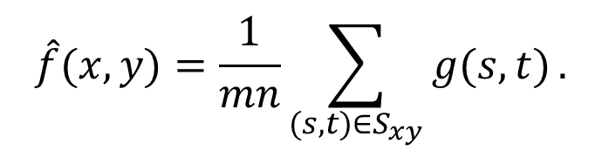
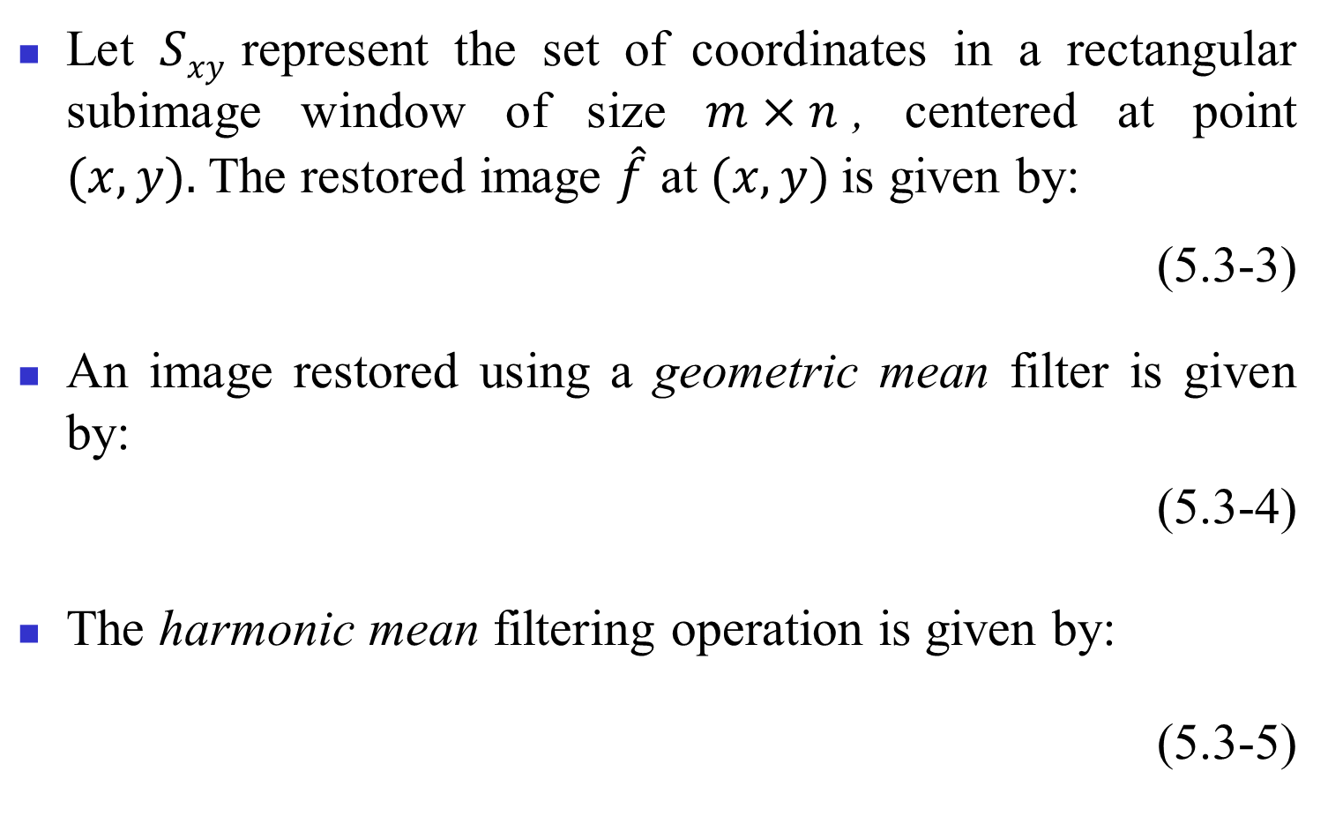
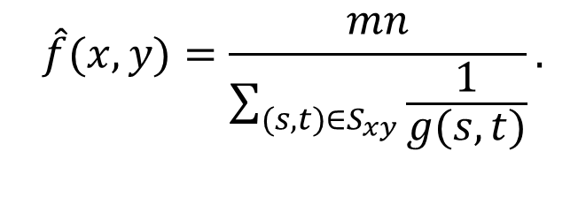
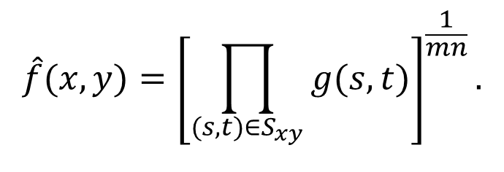
Mean filters
Let $Sxy$ represent the set of coordinates in a rectangular subimage window of size $m×n$, centered at point $(x, y).$The restored image $\hat{f}$ at $(x, y)$is given by:
(5.3-3)
An image restored using a geometric mean filter is given by:
(5.3-4)
The harmonic mean filtering operation is given by:
(5.3-5)
$$\hat{f}(x,y)=\frac{1}{mn}\sum_{(s,t)∈S_{xy}}{g(s,t)}.$$
$$\hat{f}(x,y)={\left[\prod_{(s,t)∈S_{xy}}{g(s,t)}\right]}^{\frac{1}{mn}}.$$
$$\hat{f}(x,y)=\frac{mn}{\sum_{(s,t)∈S_{xy}}{\frac{1}{g(s,t)}}}.$$

Slide 17
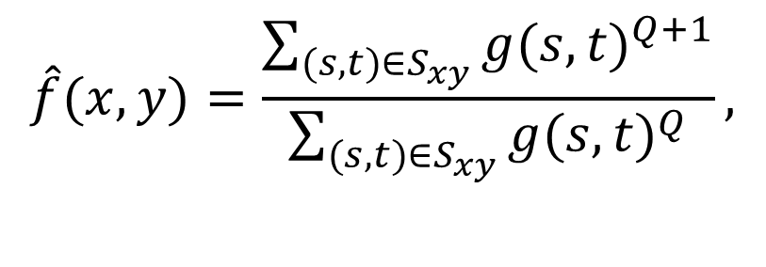
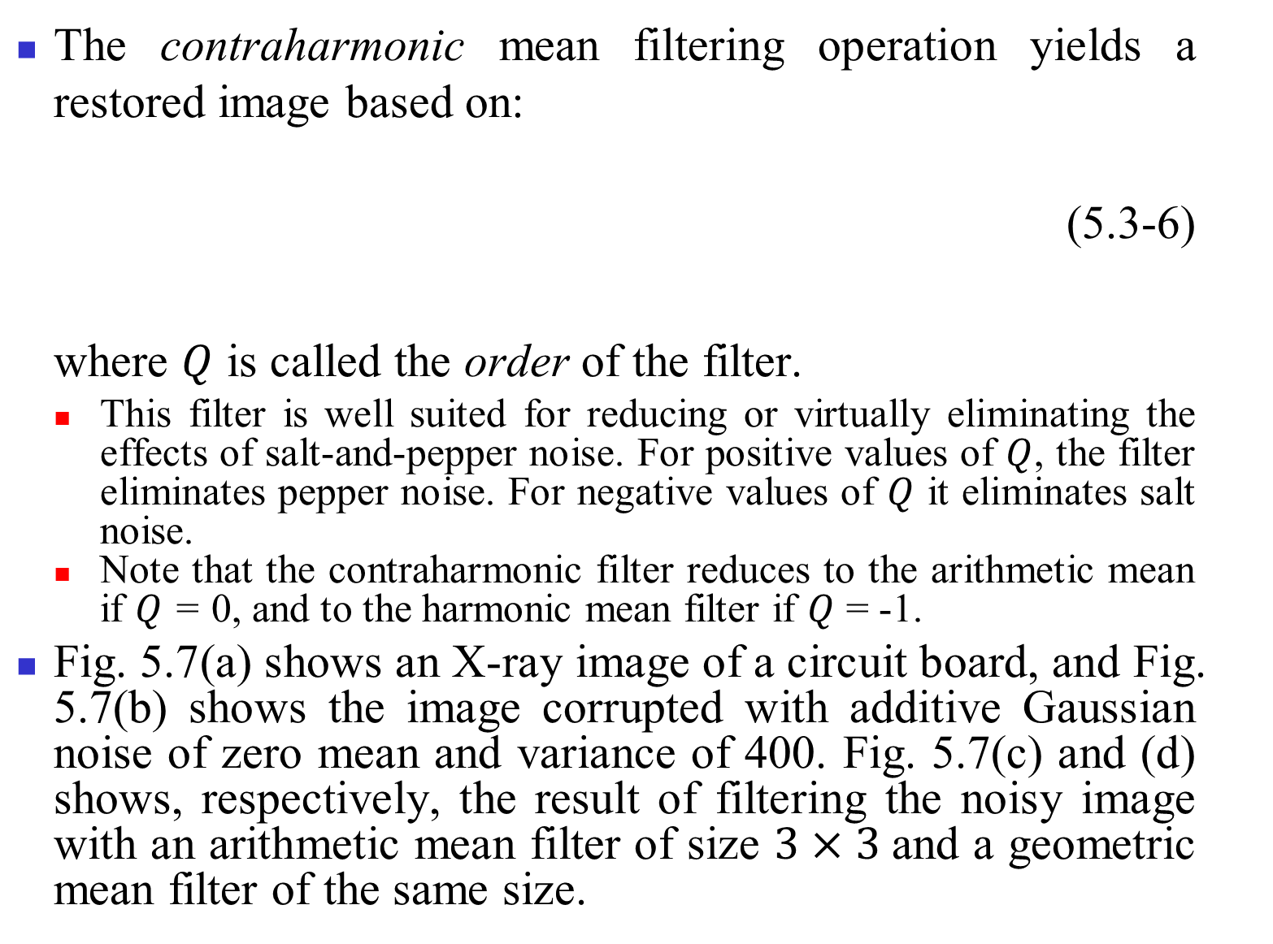
The contraharmonic mean filtering operation yields a restored image based on:
(5.3-6)
where $Q$ is called the order of the filter.
This filter is well suited for reducing or virtually eliminating the effects of salt-and-pepper noise. For positive values of $Q$, the filter eliminates pepper noise. For negative values of $Q$ it eliminates salt noise.
Note that the contraharmonic filter reduces to the arithmetic mean if $Q$ = 0, and to the harmonic mean filter if $Q$ = -1.
Fig. 5.7(a) shows an X-ray image of a circuit board, and Fig. 5.7(b) shows the image corrupted with additive Gaussian noise of zero mean and variance of 400. Fig. 5.7(c) and (d) shows, respectively, the result of filtering the noisy image with an arithmetic mean filter of size $3×3$and a geometric mean filter of the same size.
$$\hat{f}(x,y)=\frac{\sum_{(s,t)∈S_{xy}}{g(s,t)^{Q+1}}}{\sum_{(s,t)∈S_{xy}}{g(s,t)^{Q}}},$$

Slide 18
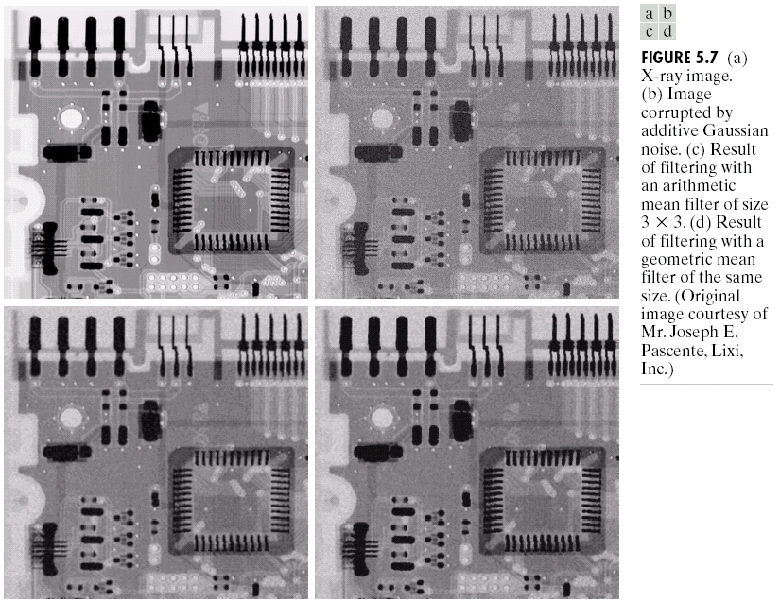

Slide 19
Fig. 5.8(a) shows the circuit image corrupted by pepper noise with probability of 0.1. Similarly, Fig. 5.8(b) shows the image corrupted by salt noise with the same probability. Fig. 5.8(c) shows the result of filtering Fig. 5.8(a) using a contraharmonic mean filter with Q = 1.5, and Fig. 5.8(d) shows the result of filtering Fig. 5.8(b) with Q = -1.5.

Slide 20
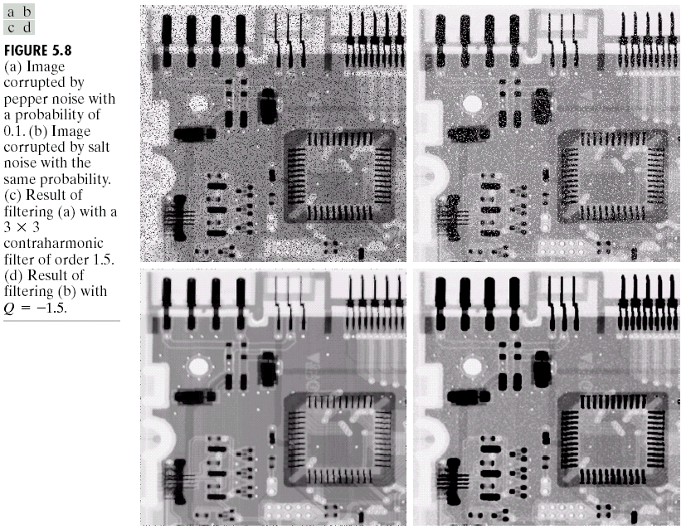

Slide 21
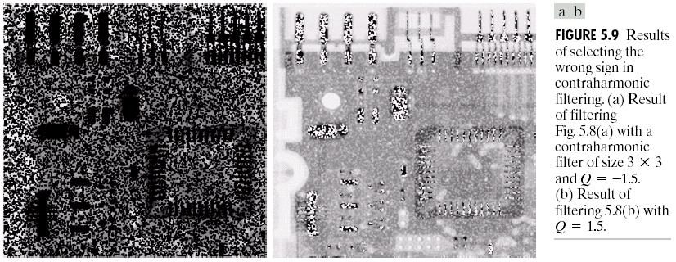
In general, the arithmetic and geometric mean filters are well suited for random noise like Gaussian or uniform noise. The contraharmonic filter is well suited for impulse noise, but it has the disadvantage that it must be known whether the noise is dark or light in order to select the proper sign for Q. Fig. 5.9 shows results of choosing the wrong sign for Q can be disastrous.

Slide 22
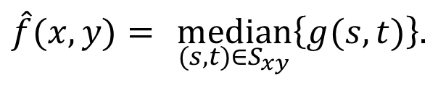
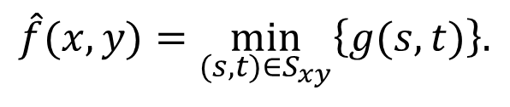
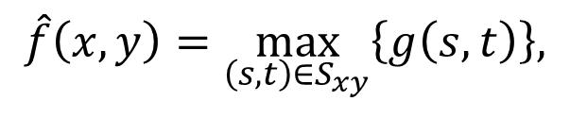
Order-statistics filters
Order-statistics filters are spatial filters whose response is based on ordering (ranking) the pixels contained in the image area encompassed by the filter.
The median filter is defined as:
(5.3-7)
Median filters are particularly effective in the presence of both bipolar and unipolar impulse noise.
The max and min filters are defined, respectively, as:
(5.3-8)
(5.3-9)
$$\hat{f}(x,y)= \underset{(s,t)∈S_{xy}}{median}\left\{g(s,t)\right\}.$$
$$\hat{f}\left(x,y\right)=\max_{\left(s,t\right)∈S_{xy}}\left\{g\left(s,t\right)\right\},$$
$$\hat{f}(x,y)=\min_{(s,t)∈S_{xy}}\left\{g(s,t)\right\}.$$

Slide 23
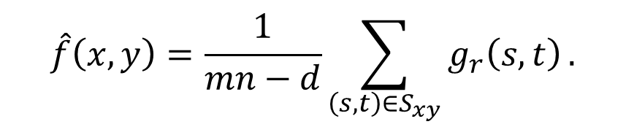
The midpoint filter is given by:
(5.3-10)
Note that this filter combines order statistics and averaging. This filter works best for randomly distributed noise, like Gaussian or uniform noise.
If we delete the d/2 lowest and the d/2 highest gray-level values of g(s, t) in the neighborhood S_{xy} and let g_{r}(s, t) represent the remaining mn – d pixels. A filter formed by averaging these remaining pixels is called an alpha-trimmed mean filter:
(5.3-11)
The alpha-trimmed filter is useful in situations involving multiple types of noise, such as a combination of salt-and-pepper and Gaussian noise.
$$\hat{f}\left(x,y\right)=\frac{1}{mn−d}\sum_{\left(s,t\right)∈S_{xy}}{g_{r}\left(s,t\right)}.$$

Slide 24
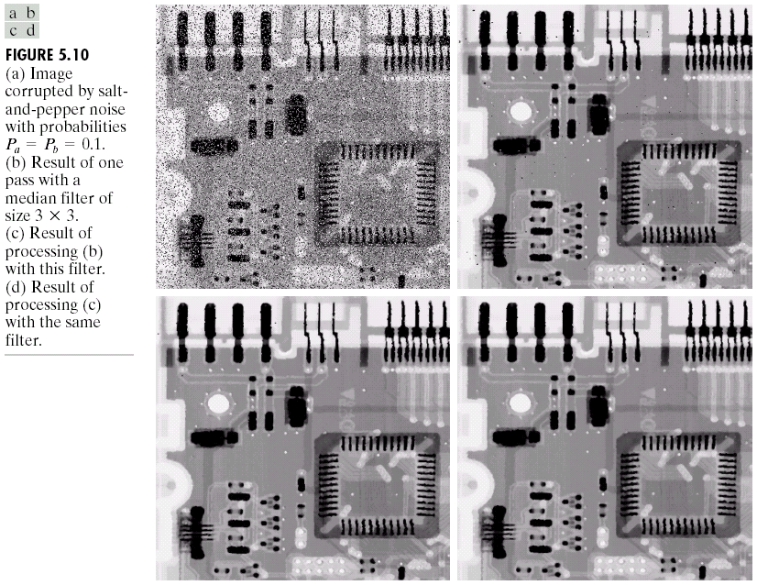
Fig. 5.10(a) shows the circuit image corrupted by impulse noise with probabilities P_{a}=P_{b}=0.1. Fig. 5.10(b)~(d) shows the results of 3 × 3 median filtering using 1, 2, and 3 iterations.

Slide 25
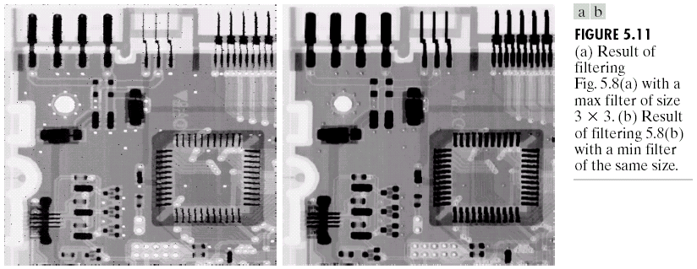
Fig. 5.11(a) shows the result of applying 3 × 3 max filtering to the pepper noise image of Fig. 5.8(a) and Fig. 5.11(b) shows the result of applying 3 × 3 min filtering to the image in Fig. 5.8(b).

Slide 26
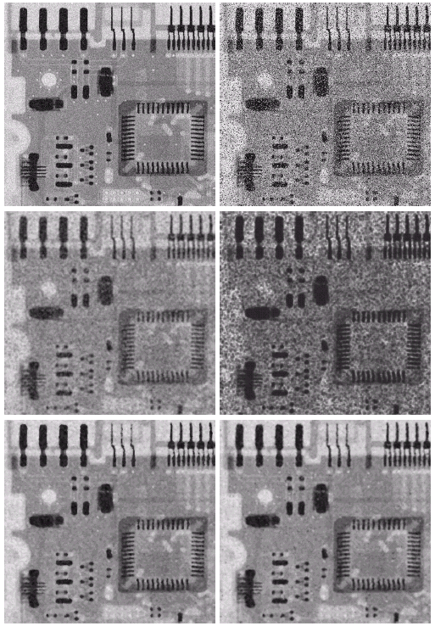
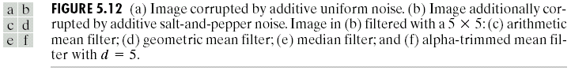
Fig. 5.12(a) shows the circuit image corrupted by additive, uniform noise of variance 800 and zero mean and then by additive salt-and-pepper noise with P_{a}=P_{b}=0.1 (shown in Fig. 5.12(b)).
Fig. 5.12(c)~(f) shows the results obtained by using 5 × 5 arithmetic mean, geometric mean, median, and alpha-trimmed mean (with d=5).
For a high value of d, the alpha-trimmed filter approaches the median filter, but still retains some smoothing capabilities.

Slide 27
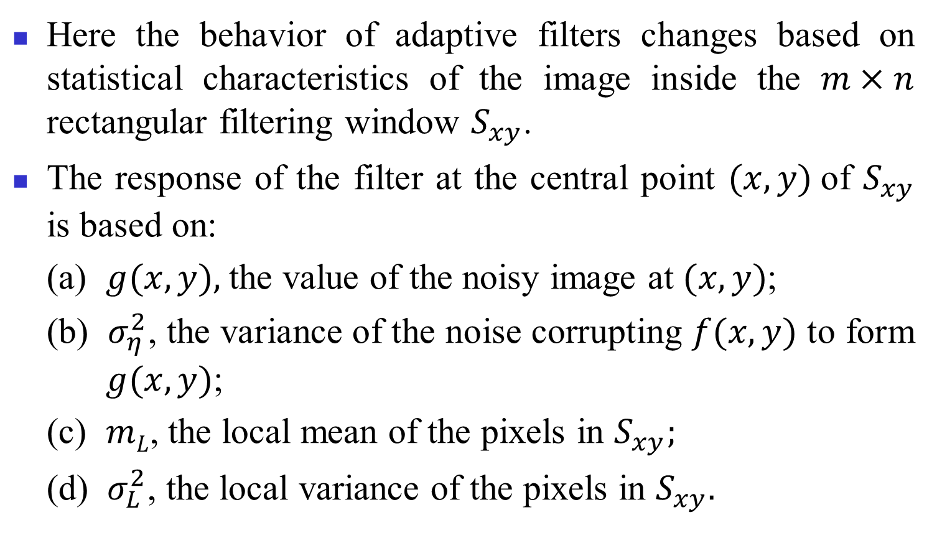
Adaptive Filters
Here the behavior of adaptive filters changes based on statistical characteristics of the image inside the $m×n$ rectangular filtering window $S_{xy}$.
The response of the filter at the central point $(x, y)$of $S_{xy}$ is based on:
(a) $g(x, y),$the value of the noisy image at $(x, y)$;
(b) $σ_{η}^{2}$, the variance of the noise corrupting $f(x, y)$ to form $g(x, y)$;
(c) $mL$, the local mean of the pixels in $S_{xy};$
(d) $σ_{L}^{2}$, the local variance of the pixels in $S_{xy}.$

Slide 28


The behavior of this filter:
1. If is zero, the filter should return simply the value of $g(x, y).$
2. If the local variance is high relative to , the filter
should return a value close to $g(x, y).$
3. If the two variances are equal, the filter should return the arithmetic mean value of the pixels in S_{xy}.
Based on the above behavior, the filter is given by:
(5.3-12)
Fig. 5.13(a) shows the circuit image corrupted by additive Gaussian noise of zero mean and a variance of 1000, Fig. 5.13(b) is the result of processing the noisy image with and arithmetic mean filter of size $7×7$, Fig. 5.13(c), which shows the result of processing the noisy image with a geometric mean filter of size $7×7$, and Fig. 5.13(d) shows the result of using the adaptive filter of Eq. (5.3-12) with
=1000.
$$\hat{f}(x,y)=g(x,y)−\frac{σ_{η}^{2}}{σ_{L}^{2}}\left[g(x,y)−m_{L}\right].$$

Slide 29


Slide 30

Adaptive median filter
Let $zmin$ = minimum gray level value in $Sxy\text{,}$
$zmax$ = maximum gray level value in $Sxy$,
$zmed$ = median of gray levels in $Sxy\text{,}$
$zxy$ = gray level at coordinates (x, y),
$Smax$ = maximum allowed size of $Sxy$.
The adaptive median filtering algorithm works in two levels, denoted level A and level B, as follows:
Level A: A1 = z_{med} – z_{min},
A2 = z_{med} – z_{max}.
If A1 > 0 AND A2 < 0, Go to level B,
Else increase the window size.
If window size ≤ S_{max}, repeat level A,
Else output z_{xy}.
Level B: B1 = z_{xy} – z_{min} ,
B2 = z_{xy} – z_{max} ,
If B1 > 0 AND B2 < 0, output z_{xy} ,
Else output z_{med}.

Slide 31

The three main purposes of the algorithm:
(1) to remove salt-and-pepper (impulse) noise,
(2) to provide smoothing of other noise that may not be impulsive,
(3) to reduce distortion, such as excessive thinning or thickening of object boundaries.
The purpose of level A is to check if the median filter output, z_{med}, is an impulse (black or white) or not.
Fig. 5.14(a) shows the circuit image corrupted by salt-and-pepper noise with probabilities P_{a}=P_{b}=0.25, Fig. 5.14(b) shows the result of 7 × 7 median filtering, and Fig. 5.14(c) shows the result of adaptive median filtering with S_{max} = 7.

Slide 32

Periodic Noise Reduction by Frequency Domain Filtering
An ideal bandreject filter is given by:
(5.4-1)
where D(u, v) is the distance from the origin of the centered frequency rectangle, W is the width of the band, and D₀ is its radial center.
$$H\left(u,v\right)=\left\{\begin{aligned}1, \text{if} D\left(u,v\right)<D_{0}−\frac{W}{2}, \\ 0\text{, }\text{if} D_{0}−\frac{W}{2}≤D\left(u,v\right)≤D_{0}+\frac{W}{2}, \\ 1, \text{if} D\left(u,v\right)>D_{0}+\frac{W}{2},\end{aligned}\right.$$

Slide 33

A Butterworth bandreject filter of order n is given by:
(5.4-2)
A Gaussian bandrejcet filter is given by:
(5.4-3)
Fig. 5.15 shows perspective plots of these three filters.

Slide 34

Fig. 5.16(a) shows an image corrupted by sinusoidal noise of various frequencies, as shown in Fig. 5.16(b). Fig. 5.16(c) shows a Butterworth bandreject filter of order 4, with the appropriate radius and width to enclose the noise impulses, and Fig. 5.16(d) shows the corresponding filtering result.

Slide 35



The transfer function $H_{bp}(u, v)$of a bandpass filter is obtained from a corresponding bandreject filter, $H_{br}(u,v)$, by:
(5.4-4)
As shown in Fig. 5.17, bandpass filtering is quite useful in isolating the effect on an image of selected frequency bands. Note that the noise pattern recovered by the bandpass filter is very close to the corrupted noise in Fig. 5.16(a).
$$H_{bp}(u,v)=1− H_{br}(u,v).$$

Slide 36

A notch filter rejects (or passes) frequencies in predefined neighborhoods about a center frequency. Fig. 5.18 shows
3-D plots of ideal, Butterworth, and Gaussian notch (reject) filters.

Slide 37



The transfer function of an ideal notch reject filter of radius D₀, with center at (u₀, v₀) and (-u₀, -v₀), is:
(5.4-5)
where
(5.4-6)
(5.4-7)
Note that the center of the frequency rectangle has been shifted to the point (M/2, N/2).
A Butterworth notch reject filter of order n is given by:
(5.4-8)
A Gaussian notch reject filter has the form:
(5.4-9)
Note that these three filters become highpass filters if u₀ = v₀ = 0.
$$H(u,v)=\left\{\begin{aligned}0\text{, }\text{if} D_{1}\left(u,v\right)≤D_{0} \text{or} D_{2}\left(u,v\right)≤D_{0}, \\ 1\text{, }\text{otherwise}\text{,} \end{aligned}\right.$$
$$D_{1}(u,v)={\left[(u−M/2−u_{0})^{2}+(v−N/2−v_{0})^{2}\right]}^{ 1/2}\text{,}$$
$$D_{2}(u,v)={\left[(u−M/2+u_{0})^{2}+(v−N/2+v_{0})^{2}\right]}^{ 1/2}.$$
$$H(u,v)=\frac{1}{1+{\left[\frac{D_{0}^{2}}{D_{1}(u,v)D_{2}(u,v)}\right]}^{n}}.$$
$$H(u,v)=1−e^{−\frac{1}{2}\left[\frac{D_{1}(u,v)D_{2}(u,v)}{D_{0}^{2}}\right]}.$$

Slide 38


The transfer functions are given by:
(5.4-10)
where $H_{np}(u,v)$is the transfer function of the notch pass filter corresponding to the notch reject filter with transfer function $H_{nr}(u,v)$.
Fig. 5.19(a) shows an image corrupted by pronounced horizontal scan lines [Fig. 4.21(a)], whose spectrum is shown in Fig. 5.19(b). The noise contribution looks like by constructing a simple ideal notch pass filter along the vertical axis of the Fourier transform, shown in Fig. 5.19(c). The spatial noise pattern is shown in Fig. 5.19(d). The processed image using the notch reject filter is shown in Fig. 5.19(e).
$$H_{np}(u,v)=1−H_{nr}(u,v)$$

Slide 39



Slide 40

Optimum Notch Filtering
Fig. 5.20(a) shows a digital image of the Martian terrain, which contains periodic image degradation and Fig. 5.20(b) shows its Fourier spectrum.
The procedure consists of first isolating the principal contributions of the interference pattern and then subtracting a variable, weighted portion of the pattern from the corrupted image.

Slide 41

The first step is to extract the principal frequency components of the interference pattern by placing a notch pass filter, H(u, v), at the location of each spike.
The Fourier transform of the interference noise pattern is:
(5.4-11)
where G(u, v) denotes the Fourier transform of the corrupted image, i.e., the interference noise pattern in the spatial domain is:
(5.4-12)
The original image f (x, y) can be obtained by subtracting the noise pattern from the corrupted image g(x, y).
We can form the filtering operation as:
(5.4-13)
where is the estimate of f(x, y) and w(x, y) is to be determined. The function w(x, y) is called a weighting or modulation function.
One approach is to select w(x, y) so that the variance of the estimate f(x, y) is minimized over a specified neighborhood of every point (x, y).
$$N\left(u,v\right)=H\left(u,v\right)G\left(u,v\right),$$

Slide 42
Consider a neighborhood of size (2a+1) by (2b+1) about a point (x, y). The “local” variance of at coordinates
(x, y) can be estimated from the samples as follows:
(5.4-14)
(5.4-15)
Based on Eqs. (5.4-14) and (5.4-15), we have:
(5.4-16)

Slide 43







Within the (2a+1) × (2b+1) neighborhood, it is assumed that:
(5.4-17)
for –a ≤ s ≤ a and –b ≤ t ≤ b, i.e.,
(5.4-18)
(5.4-19)
To minimize $σ^{2}(x,y)$, we solve
(5.4-20)
for $w(x, y).$The result is:
(5.4-21)
$$w\left(x+s,y+t\right)=w\left(x,y\right),$$
$$\overline{w(x,y)η(x,y)}=w(x,y)\overline{η}(x,y),$$
$$=\frac{1}{(2a+1)(2b+1)}\sum_{s=−a}^{a}{\sum_{t=−b}^{b}{\{[g(x+s,y+t) −w(x,y)η(x+s,y+t)] −[\overline{g}(x,y)−w(x,y)\overline{η}(x,y)]\}^{2}.}}$$
$$σ^{2}\left(x,y\right)$$
$$\frac{∂σ^{2}(x,y)}{∂w(x,y)}=0,$$
$$w(x,y)=\frac{\overline{g(x,y)η(x,y)}−\overline{g}(x,y)\overline{η}(x,y)}{\overline{η^{2}}(x,y)−{\overline{η}}^{2}(x,y)}.$$

Slide 44

Fig. 5.21 shows the Fourier Spectrum (without shifting) of the image in Fig. 5.20(a), Fig. 5.22(a) and (b) shows the Fourier spectrum of N(u, v) and the corresponding noise interference pattern , and Fig. 5.23 shows the processed image obtained by Eq. (5.4-13).

Slide 45



Slide 46





Linear, Position-Invariant Degradations
Referring the input-output relationship in Fig. 5.1,
(5.5-1)
$H$ is linear if
(5.5-2)
where $a$ and $b$ are scalars and $f1(x, y)$and $f2(x, y)$are any two input images.
If $a=b=1$, then the additivity property is:
(5.5-3)
If $f2(x, y)=0$, the homogeneity property is:
(5.5-4)
$H$ is position-invariant if
(5.5-5)
for any $f(x, y)$and any $α$ and $β$.
$f(x, y)$ can be expressed in terms of a continuous impulse function:
(5.5-6)
$$g(x,y)=H\left[f(x,y)\right]+η(x,y).$$
$$H\left[af_{1}(x,y)+bf_{2}(x,y)\right]=aH\left[f_{1}(x,y)\right]+bH\left[f_{2}(x,y)\right],$$
$$H\left[f_{1}(x,y)+f_{2}(x,y)\right]=H\left[f_{1}(x,y)\right]+H\left[f_{2}(x,y)\right].$$
$$H\left[af_{1}(x,y)\right]=aH\left[f_{1}(x,y)\right].$$
$$H\left[f(x−α,y−β)\right]=g\left(x−α,y−β\right),$$
$$f(x,y)=\int_{−∞}^{ ∞}{\int_{−∞}^{ ∞}{f(α,β)δ(x−α,y−β) d}}α dβ.$$

Slide 47






If $η(x,y)=0$, then
(5.5-7)
If $H$ is a linear operator and we extend the additivity property to integrals, then
(5.5-8)
(5.5-9)
The impulse response of $H$ or the point spread function (PSF) is:
(5.5-10)
i.e., a linear system $H$ is completely characterized by its impulse response.
The superposition integral of the first kind is:
(5.5-11)
If H is position-invariant, then
(5.5-12)
(5.5-13)
which is called the convolution integral.
$$g(x,y)=H\left[f(x,y)\right]=H\left[\int_{−∞}^{∞}{\int_{−∞}^{∞}{f(α,β)δ(x−α},y−β) dα dβ}\right].$$
$$g(x,y)=\int_{−∞}^{∞}{\int_{−∞}^{∞}{H\left[f(α,β)δ(x−α,y−β)\right] dα dβ,}} \\ =\int_{−∞}^{∞}{\int_{−∞}^{∞}{f(α,β)H\left[δ(x−α,y−β)\right] dα dβ.}}$$
$$h(x,α,y,β)=H\left[δ(x−α,y−β)\right] ,$$
$$g(x,y)=\int_{−∞}^{∞}{\int_{−∞}^{∞}{f(α,β)h(x,α,y,β) dα dβ}}.$$
$$H\left[δ(x−α,y−β)\right]=h(x−α,y−β),$$
$$g(x,y)=\int_{−∞}^{∞}{\int_{−∞}^{∞}{f(α,β)h(x−α,y−β) dα dβ,}}$$

Slide 48
In the presence of additive noise ,
(5.5-14)
If H is position invariant, Eq. (5.5-14) becomes:
(5.5-15)
(5.5-16)
(5.5-17)
i.e., a linear, spatially—invariant degradation system with additive noise can be modeled in the spatial domain as the convolution of the degradation (point spread) function with an image, followed by the addition of noise.

Slide 49
Degradation Function Estimation
Three principal degradation function estimation methods:
1. Observation
2. Experimentation
3. Mathematical modeling
The process of restoring an image by using a degradation function that has been estimated in some way sometimes is called blind deconvolution.

Slide 50
Estimation by image observation
Let the observed subimage be denoted by g_{s}(x, y), and let the constructed subimage be denoted by . Within a strong-signal area, we have:
(5.6-1)
which can be used to deduce H(u, v) if it is position-invariant.

Slide 51


Estimation by experimentation
The idea is to obtain the impulse response of the degradation by imaging an impulse (small dot of light) using the same system settings.
As shown in Fig. 5.24, an impulse is simulated by a bright dot of light, which has a constant Fourier transform. Based on Eq. (5.5-17), we have:
(5.6-2)
where G(u, v) is the Fourier transform of the observed image and A
is a constant
describing
the strength of
the impulse.
$$H\left(u,v\right)=\frac{G\left(u,v\right)}{A},$$
51

Slide 52

Estimation by modeling
A degradation model proposed by Hufnagel and Stanley [1964] is based on the physical characteristics of atmospheric turbulence. This model
(5.6-3)
where k is a constant that depends on the nature of the turbulence.
The Guassian lowpass filter (LPF) is used sometimes to model mild, uniform blurring.
Fig. 5.25 shows the simulated blurring images using Eq. (5.6-3) with k=0.0025 (b), k=0.001 (c), and k=0.00025 (d).
$$H(u,v)=e^{−k(u^{2}+v^{2})^{5/6}}\text{,}$$

Slide 53

Suppose that an image f(x, y) undergoes planar motion and that x₀(t) and y₀(t) are the time varying components of motion in the x- and y-directions, respectively.

Slide 54
Assuming that shutter opening and closing takes place instantaneously, and that the optical imaging process is perfect, isolates the effect of image motion.
If T is the duration of the exposure, the blurred image is:
(5.6-4)
(5.6-5)
(5.6-6)
(5.6-7)
If
(5.6-8)
Eq. (5.6-7) becomes:
(5.6-9)
,
.

Slide 55


If the motion variables x₀(t) and y₀(t) are known, the transfer function H(u, v) can obtained directly from Eq. (5.6-8).
If the image undergoes uniform linear motion in the x-direction only with x₀(t)=at/T and y₀(t)=0, i.e., x₀(T)=a, Eq. (5.6-8) yields:
(5.6-10)
Note that H vanishes at values of u given by u = n/a, where n is an integer.
If x₀(t)=at/T and y₀(t)=bt/T, then the degradation function becomes:
(5.6-11)
$$H(u,v)=\int_{0}^{T}{e^{−j2πux_{0}(t)}dt} \\ =\int_{0}^{T}{e^{−j2πuat/T}dt} \\ =\frac{T}{πua}\sin{(}πua)e^{−jπua}.$$
$$H\left(u,v\right)=\frac{T}{π\left(ua+vb\right)}\sin\left[π\left(ua+vb\right)\right]e^{−jπ\left(ua+vb\right)}.$$

Slide 56

Fig. 5.26(b) shows the blurred image of Fig. 5.26(a) by applying Eq.(5.6-11) with a = b = 0.1 and T = 1.

Slide 57




Inverse Filtering
If the degradation function $H(u, v)$is a variable, the estimated original image is:
(5.7-1)
Considering the noise term, we have (based on Eq. 5.5-17):
(5.7-2)
If the degradation function used is:
with $k=0.0025$. The $M/2$ and $N/2$ constants are offset values.
Applying Eq. (5.7-1), Fig. 5.27(b)-(d) shows the results of cutting off values of the ratio $G(u, v)/H (u, v)$ outside a radius of 40,70, and 85, respectively. The cut off was implemented by applying to the ratio a Butterworth lowpass function of order 10.
In Fig. 5.27, radii near 70 yield the best visual results.
$$\hat{F}(u,v)=\frac{G(u,v)}{H(u,v)}.$$
$$\hat{F}(u,v)=F(u,v)+\frac{N(u,v)}{H(u,v)}.$$
$$H(u,v)=e^{−k[(u−M/2)^{2}+(v−N/2)^{2}]^{5/6}}\text{,}$$

Slide 58


Slide 59


Minimum Mean Square Error (Wiener) Filtering
Considering image and noise as random processes, we can find an estimate $\hat{f}$ of the uncorrupted image $f$ such that the mean square error (MSE), defined as:
(5.8-1)
is minimized.
$$e^{2}=E\left\{(f−\hat{f})^{2}\right\}$$

Slide 60
Based on the assumption that (1) the noise and the image are uncorrelated, (2) one or the other has zero mean, and (3) the gray levels in the estimate are a linear function of the levels in the degraded image, we have:
(5.8-2)
.

Slide 61


It is called the Wiener filter, the minimum MSE filter, or the least square error filter.
The terms in Eq.(5.8-2) are as follows:
$H(u, v) =$degradation function
$H∗(u, v) =$complex conjugate of $H(u, v)$
$|H(u, v)|2 = H∗(u, v)H(u, v)$
$S_{η}\left(u, v\right)={\left|N\left(u, v\right)\right|}^{2}=$power spectrum of the noise [see Eq. (4.20)]
$S_{f}\left(u, v\right)={\left|F\left(u, v\right)\right|}^{2}=$power spectrum of the undegraded image.
Because $S_{f}\left(u, v\right)$is seldom known, Eq. (5.8-2) can be approximated by:
(5.8-3)
where K is a specified constant.
$$\hat{F}\left(u,v\right)=\left[\frac{1}{H\left(u,v\right)}\frac{|H(u,v)|^{2}}{|H(u,v)|^{2}+K}\right]G\left(u,v\right),$$

Slide 62

Fig. 5.28(a) shows the full inverse-filtered result shown in Fig. 5.27(a), Fig. 5.28(b) shows the radially limited inverse filter result of Fig. 5.27(c), and Fig. 5.28(c) shows the Wiener filter result by Eq. (5.8-3).
Fig. 5.29(a)~(c) shows the blurred image of Fig. 5.26(b) corrupted by additive Gaussian noise N(0, 650), the result of direct inverse filtering, and the result of Wiener filtering [Eg. (5.8-3)].

Slide 63

Fig. 5.29(d)~(f) shows the similar sequence of Fig. 5.29(a)~(c), but with the level of noise variance reduced by one order of magnitude from (a).
Fig. 5.29(g)~(i) shows the similar sequence, but noise variance reduced by five orders of magnitude from (a).

Slide 64




Constrained Least Squares Filtering
Eq. (5.5-16) can be expressed in the vector-matrix form:
(5.9-1)
If $g(x, y)$is of size $M×N$, f and $η$ are of size $M×N$, and the matrix has dimensions $MN×MN$.
We want to find the minimum of a criterion function, C, defined as:
(5.9-2)
subject to the constraint:
(5.9-3)
where ${\left\|w\right\|}^{2}≜w^{T}w$ is the Euclidean vector norm, $\hat{f}$ is the estimate of the undegraded image, and the Laplacian operator $∇^{2}$ is defined in Eq. (3.7-1).
$$g=Hf+η.$$
$$C=\sum_{x=0}^{M−1}{\sum_{y=0}^{N−1}{{\left[∇^{2}f(x,y)\right]}^{2}}},$$
$$||g−H\hat{f}||^{2}=|\left|η\right||^{2},$$

Slide 65




The frequency domain solution is:
(5.9-4)
where $γ$ is a parameter that must be adjusted so that the constraint in Eq. (5.9-3) is satisfied, and $P(u, v)$is the Fourier transform of the function:
(5.9-5)
Fig. 5.30 shows the result of processing Fig. 5.29(a), (d), and (g) with constrained least squares filters, in which $γ$ are selected manually to yield the best visual results.
$$\hat{F}\left(u,v\right)=\left[\frac{H∗\left(u,v\right)}{{\left|H\left(u,v\right)\right|}^{2}+γ{\left|P\left(u,v\right)\right|}^{2}}\right]G\left(u,v\right),$$
$$p(x,y)=\left[\begin{matrix}0 & −1 & 0 \\ −1 & 4 & −1 \\ 0 & −1 & 0\end{matrix}\right].$$

Slide 66




If a “residual” vector $r$ is defined as:
(5.9-6)
(5.9-7)
is a monotonically increasing function of $γ$.
We want to adjust gamma so that
(5.9-8)
where a is an accuracy factor.
The procedure to determine gamma $γ$:
1. Specify an initial value of $γ$.
2. Compute ||r||².
3. Stop if Eq. (5.9-8) is satisfied; otherwise return to Step 2 after increasing $γ$ if or decreasing $γ$ if . Use the new value of $γ$ in Eq. (5.9-4) to recompute the optimum estimate
$$r=g−H\hat{f},$$
$$∅(γ)=r^{T}r=|\left|r\right||^{2},$$
$$||r||^{2}=||η||^{2}±a$$

Slide 67






From Eq. (5.9-6), we have:
(5.9-9)
(5.9-10)
where $r(x, y)$and $R(u, v)$are a Fourier transform pair.
Consider the variance of the noise over the entire image:
(5.9-11)
(5.9-12)
The useful result:
(5.9-13)
which is based on the assumption that the noise and the signal are uncorrelated.
$$R\left(u,v\right)=G\left(u,v\right)−H\left(u,v\right)\hat{F}\left(u,v\right),$$
$$||r||^{2}=\sum_{x=0}^{M−1}{\sum_{y=0}^{N−1}{r^{2}(x,y)}},$$
$$σ_{η}^{2}=\frac{1}{MN}\sum_{x=0}^{M−1}{\sum_{y=0}^{N−1}{{\left[η(x,y)−m_{η}\right]}^{2}}},$$
$$m_{η}=\frac{1}{MN}\sum_{x=0}^{M−1}{\sum_{y=0}^{N−1}{η(x,y)}}.$$
$$||η||^{2}=MN\left[σ_{η}^{2}+m_{η}^{2}\right] ,$$

Slide 68


Fig. 5.31(a) shows the result by using the above algorithm to estimate the optimum filter for restoring Fig. 5.25(b), where a = 0.25 and the initial $γ$ is 10⁻⁵.
Fig. 5.31(b) shows the result with the wrong estimate of noise parameters.

Slide 69

Geometric Mean Filters
A generalization of the Wiener filter, called the geometric mean filter, is:
(5.10-1)
with and being positive, real constants.
When = 1 this filter reduces to the inverse filter. With $α=0$ the filter becomes the so-called parametric Wiener filter, which reduces to the standard Wiener filter when $β$ = 1.
,

Slide 70
Geometric Transformations
Geometric transformations, or rubber-sheet transformations, may be viewed as the process of “printing” an image on a sheet of rubber and then stretching this sheet according to some predefined set of rules.
A geometric transformation consists of two operations:
(1) a spatial transformation defining the “rearrangement” of pixels on the image plane;
(2) gray-level interpolation dealing with the assignment of gray levels to pixels in the spatially transformed image.

Slide 71

An image f(x, y) undergoes geometric distortion to produce an image g(x', y'). The transformation may be expressed as:
x' = r(x, y) (5.11-1)
y' = s(x, y) (5.11-2)
where r(x, y) and s(x, y) are the spatial transformations that produced the geometrically distorted image g(x', y').
Usually, we formulate the spatial relocation of pixels by the use of tiepoints, which are a subset of pixels whose location in the input (distorted) and output (corrected) images is known precisely.
Fig. 5.32 shows quadrilateral regions in a distorted and corresponding corrected image. The vertices of the quadrilaterals are corresponding tiepoints.

Slide 72
If the geometric distortion process within the quadrilateral regions is modeled by a pair of bilinear equations:
r(x, y) = c₁x + c₂y + c₃xy + c_{4,} (5.11-3)
s(x, y) = c₅x + c₆y + c₇xy + c_{8,} (5.11-4)
i.e., x' = c₁x + c₂y + c₃xy + c_{4,} (5.11-5)
y' = c₅x + c₆y + c₇xy + c_{8.} (5.11-5)
Eight known tiepoints can be used to solve the eight coefficients c_{i}, i = 1, 2, …, 8.
Usually, integer coordinates (x, y) are used to yield the restored image . However, Eqs. (5.11-5) and (5.11-6) can yield noninteger (x', y'), due to the coefficients c_{i}.

Slide 73


As shown in Fig. 5.33, the simplest scheme for gray-level interpolation is based on a nearest neighbor approach , also called zero-order interpolation:
(1) the mapping of integer $(x, y)$coordinates into fractional coordinates $\left(x^{′}, y^{′}\right)$,
(2) the selection of the closest integer coordinate neighbor to $(x′, y^{′})$,
(3) the assignment of the gray level of this nearest neighbor to the pixel located at $(x, y)$.
The simple nearest neighbor interpolation may produce undesirable artifacts, such as distortion of straight lines.
Smoother results can be obtained by using more sophisticated techniques, such as cubic convolution interpolation.

Slide 74

For general-purpose image processing a bilinear interpolation approach that uses the gray levels of the four nearest neighbors usually is adequate.
Based on the bilinear interpolation, the gray-level value $v(x′, y′)$is:
$v\left(x^{′}, y^{′}\right)=ax^{′}+by^{′}+cx^{′}y^{′}+d ,$ (5.11-7)
where the four coefficients are easily determined from the four equations in four unknowns that can be written using the four known neighbors of $(x′, y′)$.
When these coefficients have been determined, $v(x′, y′)$is computed and this value is assigned to the location in $f(x, y)$that yields the spatial mapping into location $(x′, y′)$.
Fig. 5.34(a) shows an image with 25 regularly spaced tiepoints, Fig. 5.34(b) shows a simple rearrangement of the tiepoints to create geometric distortion, Fig. 5.34(c) shows the geometrically distorted image using nearest neighbor interpolation, and Fig. 5.34(d) shows the restored image.
Fig. 5.34(e) shows the distored image using bilinear interpolation and Fig. 5.34(f) shows the restored image.

Slide 75



Slide 76

Fig. 5.35(a) shows the original image, Fig. 5.35(b) shows the distored image using bilinear interpolation (the same parameters as in Fig. 5.34(e)), Fig. 5.35(c) shows the difference between (a) and (b), and Fig. 5.35(d) shows the restored image.

